Slide 1
XI Meeting of Young Chemical Engineers
Faculty of Chemical Engineering and Technology
18th and 19th February 2016, Zagreb
Quantification of capsaicinoids in hot pepper samples using voltammetry of microparticles
Lara Čižmek^{1,*}, Šebojka Komorsky-Lovrić¹, Ivana Novak Jovanović²
¹Ruđer Bošković Institute, Bijenička 54, Zagreb
*Email: lcizmek@irb.hr
Croatian Science Foundation
²Institute for Medical Research and Occupational Health, Ksaverska 2, Zagreb

Slide 2
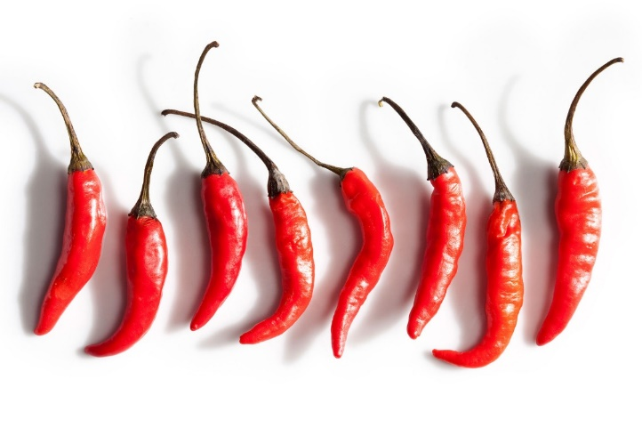
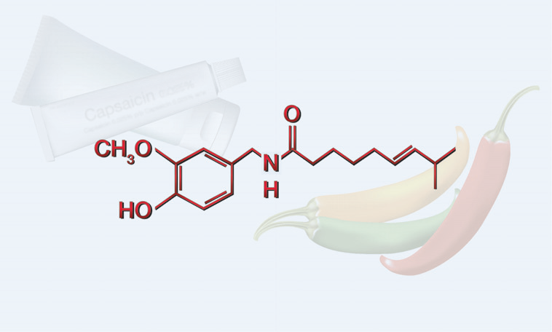
Introduction
Methods
Results
Conclusion
Pungency in chilli peppers
Chillies are used as pungent flavor in food, natural plant colour, pharmaceutical ingredients and as sprays for riot control and self-defense
Capsaicinoids - the pungent flavor of chillies
alkaloids found only in the genus Capsicum (family: Solanaceae)
capsaicin and dihydrocapsaicin together account for about 90% of pungency
Capsaicin
trans-8-methyl-N-vanillyl-6-nonenamide
pharmaceutical properties (topical analgesic against arthritis pain and inflammation, antimutagenecity effects and a high antioxidant activity)
© 2011 American Association for Cancer Research
Figure 1. Chemical structure of capsaicin.

Slide 3
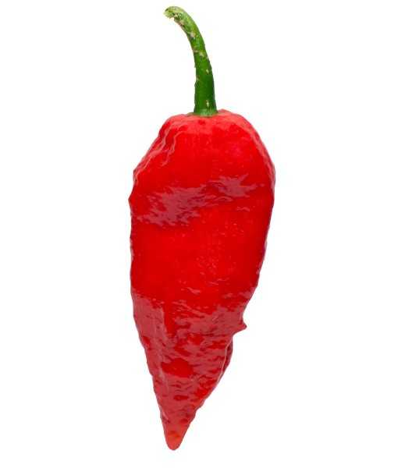
Introduction
Methods
Results
Conclusion
Measurement of pungency in chilli peppers
Types of Peppers
Scoville Heat Units
Chilli pungency is measured in Scoville Heat Units (SHU)
Scoville organoleptic test (Scoville, 1912)
- organoleptic method (subjective)
Bhut Jolokia
880 000 – 1 041 427
Red Savina
350000 – 577000
Fatalli
125000–400000
Spectrophotometry
(Perucka and Oleszek, 2000; Davis et al., 2007)
Habanero Orange
150000 – 325000
Carolina Cayenne
100000 – 125000
High-performance liquid chromatography (HPLC) method
(Collins et al., 1995; Perucka and Oleszek, 2000; Woodbury, 1980)
Jalapeno
2500 – 5000
Ancho
1000 – 2000
Electrochemical tehniques
(Kachoosangi et al., 2008; Yardım, 2011; Ya et al., 2012)
Hungarian wax pepper
1000 – 8000
Figure 2. http://www.chilliworld.com/factfile/scoville-scale-of-hot-sauces.asp

Slide 4
Introduction
Methods
Results
Conclusion
Voltammetry of immobilized microparticles
Developed by F. Scholz, L. Nitschke and G. Henrion in 1990s
Characterization of solid materials consisting in the transfer of extremely small amounts of the solid substance by abrasion onto the surface of a suitable solid electrode (paraffin impregnated graphite electrode (PIGE))
Applied to various minerals, alloys and organic compounds (T. Grygar et al.,2002, Š. Komorsky-Lovrić et al.,1999, A. Doménech-Carbó et al., 2009)
Identification of illegal substances (Š. Komorsky-Lovrić et al., 1999, I. Novak et al., 2013)
Estimation of antioxidative activity in tea leaves, fruits and vegetables (Š. Komorsky-Lovrić and I. Novak, 2009, 2011).
Problem: quantification!
The amount of sample transferred to the electrode surface is unknown
Standard addition method applied to voltammetry of immobilized microparticles
Introduced by A. Doménech-Carbó and associates in 2004.
Determination of the mass fraction of a depositable metals in materials (A. Doménech-Carbó et al., 2004)
Recently, the method was used for determinantion of antidepressants drugs (A. Doménech-Carbó et al., 2013)

Slide 5
Introduction
Methods
Results
Conclusion
Materials and methods
Chilli pepper
(m)
Indigo
(m_{R})
Standard
capsaicin
(m_{X}^{add})
Square-Wave Voltammetry
Solid electroactive reference compound with independent electrochemical response
contains unknown amount m_{X} of an electroactive compound, X - CAPSAICIN
$$f=\frac{m_{X}}{m}=?$$
our analytical objective
Standard addition method
f_{X} – mass fraction of X in the real sample
Experimental conditions: frequency 150 Hz and pH 11
Electrolyte: 0.1 M KNO₃ buffered to the specific pH
Working electrode: paraffin-impregnated graphite rod (diameter 5 mm, length 50 mm)

Slide 6
Introduction
Methods
Results
Conclusion
Now, each specimen will contain a mass m of pristine sample (containing an unknown mass fraction f of X), a mass m_{R} of reference compound with known mass fraction f_{R} of R, and a mass m_{X}^{add} of added standard with known mass fraction f_{X} of X. Then, the i_{p}(X)/i_{p}(R) ratio should satisfy the relationship:
G_{X} – electrochemical coefficient of response for X
G_{R} - electrochemical coefficient of response for R
M_{X} – molecular mass of X
M_{R} – molecular mass of R
$$\frac{i_{p}(X)}{i_{p}(R)}=\left(\frac{G_{X}}{G_{R}}\right)∙\frac{M_{R}}{M_{X}}∙\left[\left(\frac{f}{f_{R}}\right)∙\left(\frac{m}{m_{R}}\right)+\left(\frac{f_{X}}{f_{R}}\right)∙\left(\frac{m_{X}^{add}}{m_{R}}\right)\right]$$
Accordingly, plots of i_{X}/i_{R} vs. m_{X}/m_{R} should give a straight line of slope (G_{X}/G_{R})(M_{R}/M_{X})(f_{X}/f_{R}) and ordinate at the origin (G_{X}/G_{R})(M_{R}/M_{X})(m/m_{R})(f/f_{R}).
Table 1. Example of the prepared samples for measurement.
Sample | m / mg | m_{R} / mg | m_{X}^{add} / mg | m/m_{R} | m_{X}^{add}/m_{R}
1 | 15 | 30 | 0 | 2 | 0
2 | 15 | 30 | 0.01 | 2 | 0.00033
3 | 15 | 30 | 0.03 | 2 | 0.0010
4 | 15 | 30 | 0.05 | 2 | 0.0017
5 | 15 | 30 | 0.1 | 2 | 0.0033
6 | 15 | 30 | 0.5 | 2 | 0.0168
7 | 15 | 30 | 1 | 2 | 0.0330
Then, the absolute mass fraction of X in the sample can be calculated from the abscissa at the origin, AO = (m/m_{R})(f/f_{X}) as:
$$f=(AO)∙f_{X}∙\frac{m_{R}}{m}∙DF$$
DILLUTION FACTOR

Slide 7
Introduction
Methods
Results
Conclusion
Results
Figure 5. Square-wave voltammetry of mixture of indigo and capsaicin microparticles immobilized on the surface of PIGE and immersed in 0.1 M KNO3, pH 11.
Figure 3. Square-wave voltammetry of indigo microparticles immobilized on the surface of PIGE and immersed in 0.1 M KNO3, pH 11.
Figure 4. Square-wave voltammetry of capsaicin microparticles immobilized on the surface of PIGE and immersed in 0.1 M KNO3, pH 11.

Slide 8
Introduction
Methods
Results
Conclusion
Pepper: Bhut Jolokia
Table 2. Net peak currents and net peak potentials of two electroactive compounds.
Figure 6. Square-wave voltammetry of Bhut Jolokia samples with different additions of capsaicin microparticles in 0.1 M KNO3, pH 11.
Figure 7. Voltammograms for all the additions of capsaicin microparticles in analysis of chilli pepper Bhut Jolokia.

Slide 9
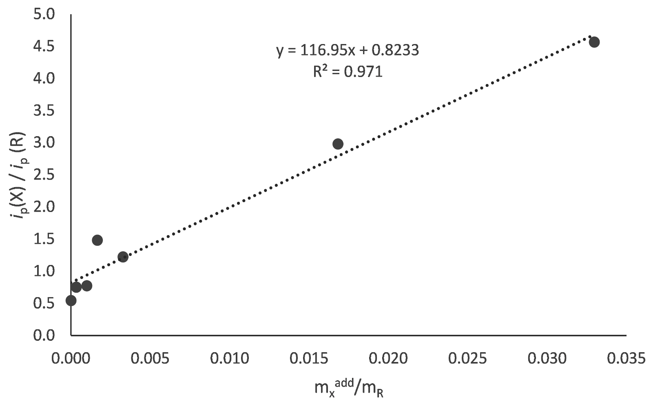
Introduction
Methods
Results
Conclusion
The mass fraction of capsaicinoids in real samples of chilli peppers can be calculated according to the formula mentioned before:
$$f=(AO)∙f_{X}∙\frac{m_{R}}{m}∙DF$$
$$f=0.00703976∙1∙\frac{30 mg}{15 mg}∙5$$
$$f=0.0703976$$
Conversion to Scoville Heat Units (SHU) (Todd et al., 1977)
Figure 8. Experimentally determined peak currents for capsaicin and indigo versus known mass adition of capsaicin divided by mass of refrence compound, indigo.
Multiply with 1,6x10⁷
Good correlation with literature data
Linear equation:
$$y=116.95x+0.8233$$
Literature data:
Abscissa at the origin, AO (from the linear equation):
1 126 361.7 SHU
880 000 – 1 041 427 SHU
$$AO=0.00703976$$

Slide 10
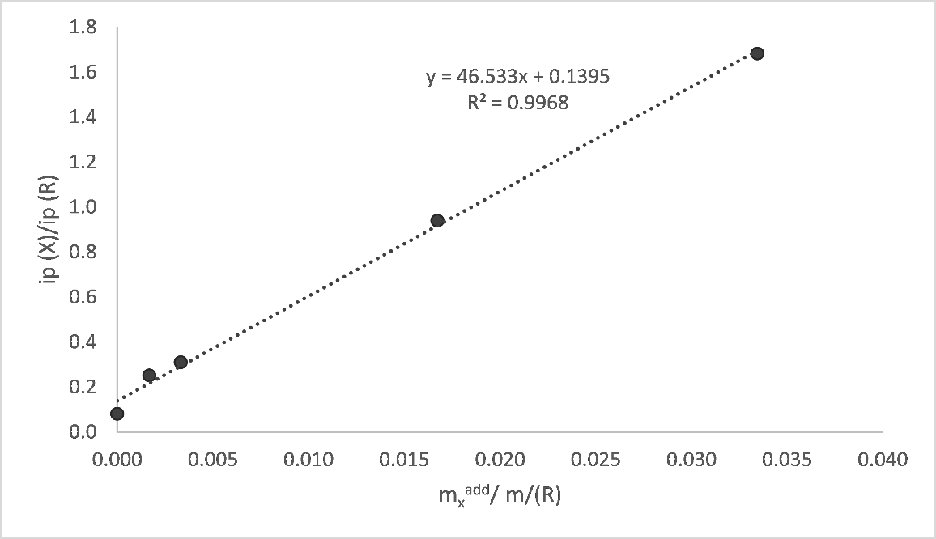
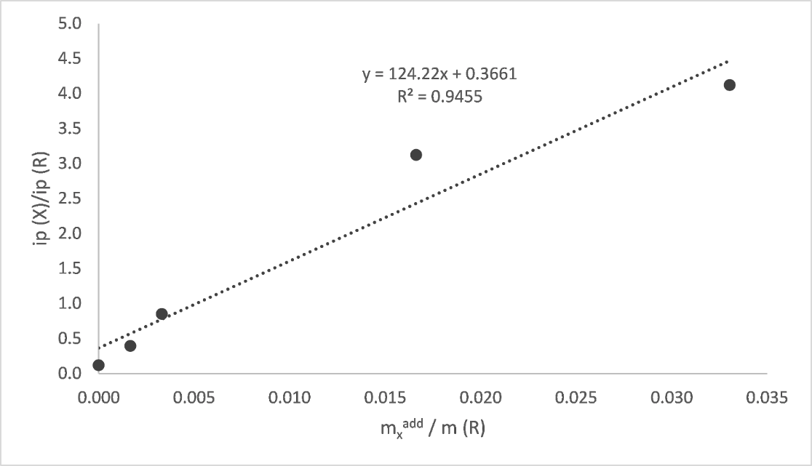
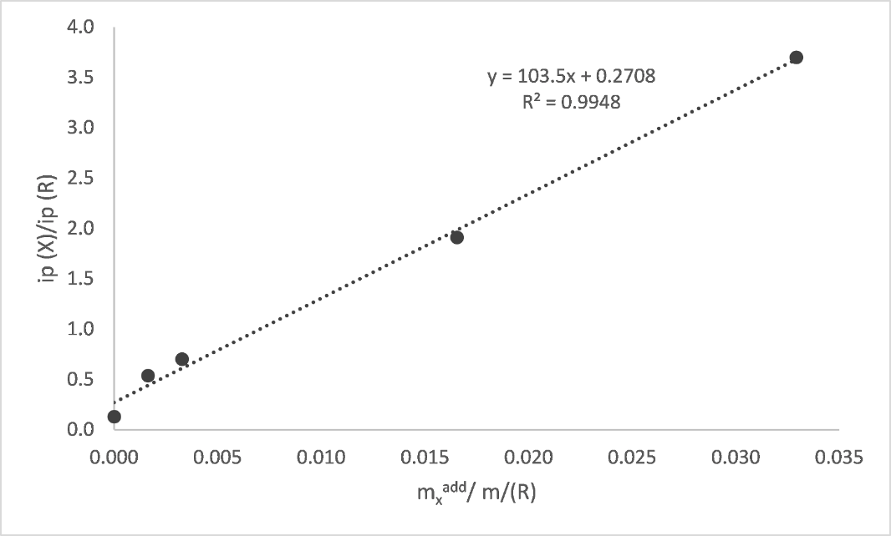
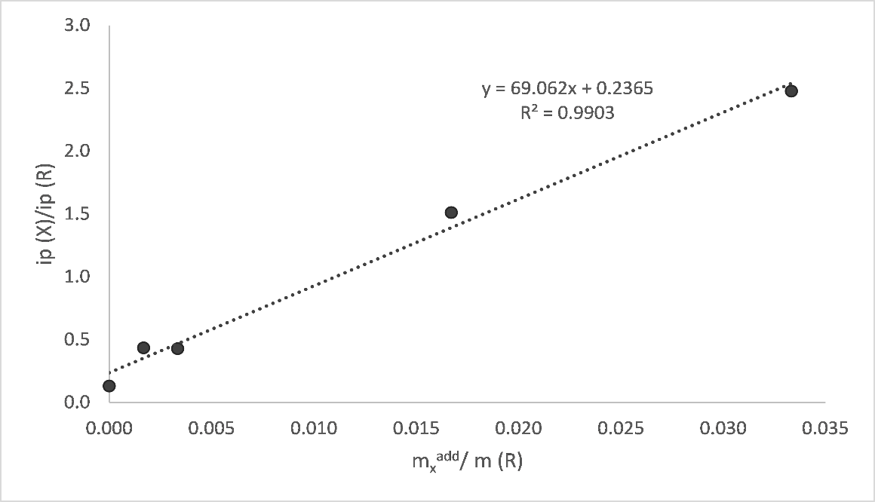
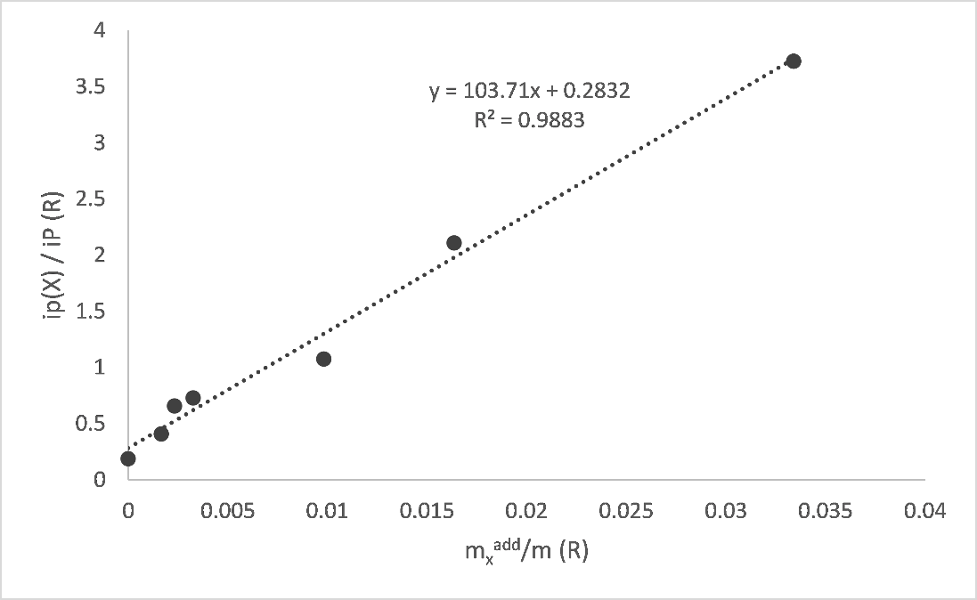
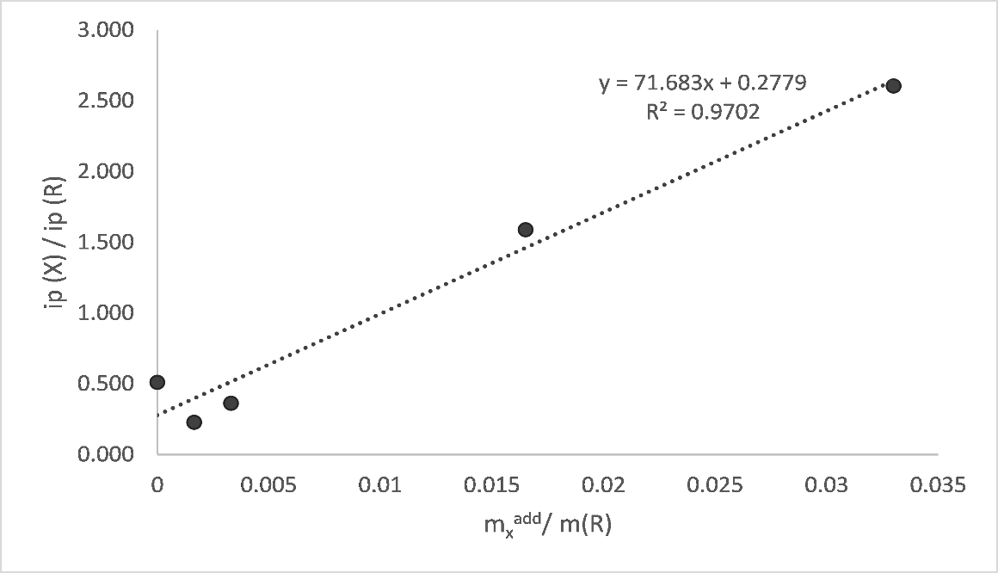
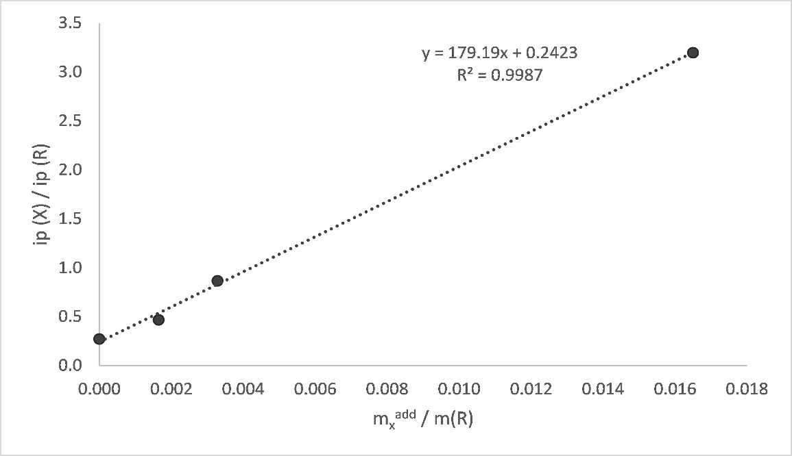
Introduction
Methods
Results
Conclusion
Habanero Orange (SHU 150000 – 325000)
Red Savina (SHU 350000 – 577000)
Ancho (SHU 1000 – 2000)
Jalapeno (SHU 2500 – 5000)
Fatalli (SHU 125000 – 400000)
Hungarian Wax Pepper (SHU 1000 – 8000)
Carolina Cayenne (SHU 100000 – 125000)

Slide 11
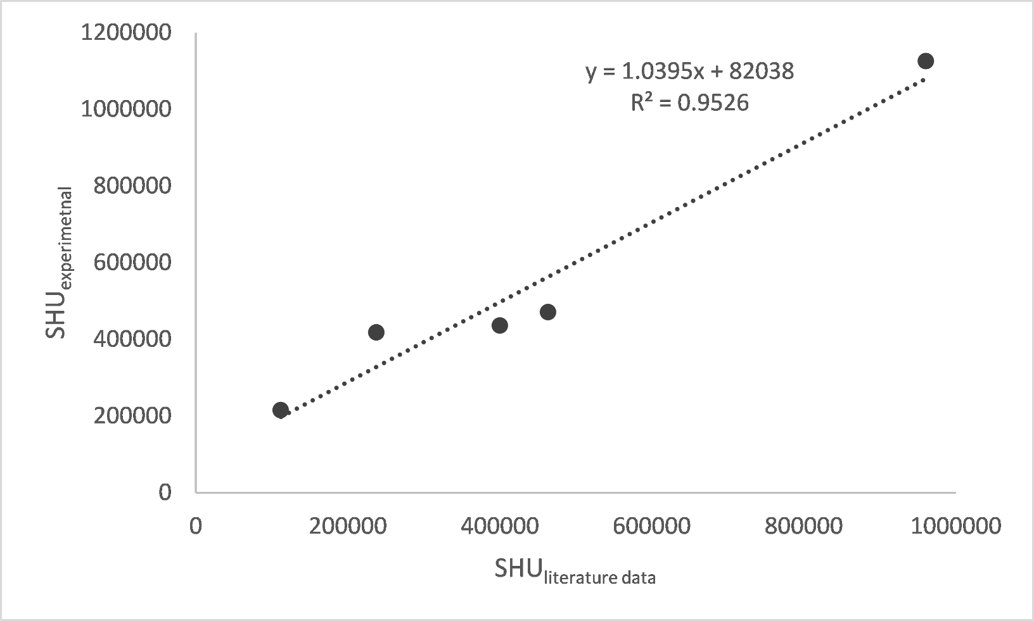
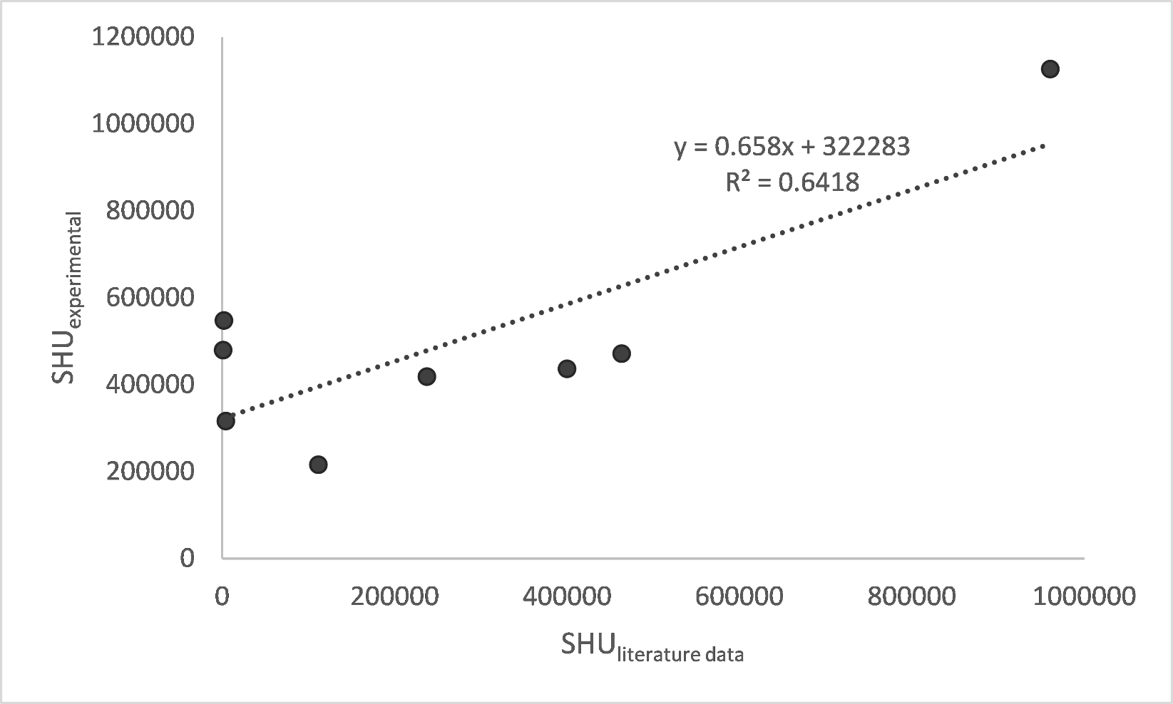
Introduction
Methods
Results
Conclusion
Comparison of experimentally calculated Scoville Heat Units and from literature data
Table 3. Scoville Heat Units for tested peppers.
 | SHU_{literature} | SHU_{experimental}
Bhut Joloki | 960713.5 | 1126361.7
Red Savina | 463500 | 471552
Fatalli | 400000 | 436910.62
Habanero Orange | 237500 | 418640
Carolina Cayenne | 112000.5 | 216351
Jalapeno | 2500 | 547913.5
Ancho | 1500 | 479659.6
Hungarian Wax | 4500 | 316740.78
Figure 9. Correlation between literature data and experimental results for Scoville Heat Units of peppers.

Slide 12
Introduction
Methods
Results
Conclusion
Conclusion
Quantification of capasaicinoids in chilli pepper samples used as food additives can be made using standard addition method using the voltammetry of microparticles methodology.
The method is based on the record of the solid-state voltammetric signals for the electroactive analyte and an electroactive reference compound assuming that such signals are independent and appearing at separated potentials.
The method is reproducible and applicable to samples with higher concentrations of capsaicinoids.
In samples with lower concentration of capsaicinoids, estimated pungency is not in agreement with provided literature data probably due to the addition of relatively high concentration of standard capsaicin which then gives higher response then the ones in sample.
Under optimized conditions, the method provides satisfactory results for the determination of capsaicinoids in real samples of chilli peppers.
The use of a standard addition method based on SQWV measurements on sample plus reference-modified PIGEs provide a fast and sensitive procedure for determining the mass fraction of capsaicinoids in solid samples of chilli peppers.

Slide 13
Thank you for your attention!
The financial support by the Croatian Foundation in the frame of the project number IP-11-2013-2072 is gratefully acknowledged.

